Slide 1

Chapter 4
LANGUAGE
IMPLEMENTATION

Slide 2
Ch. 4 - Language Implementation
Programming Languages are Text-based!
Language implementation systems must analyze source code, regardless of the specific implementation approach
Nearly all syntax analysis is based on a formal description of the syntax of the source language (usually with BNF)

Slide 3
Implementation Methods
Compilation
  Programs are translated into machine language
Pure Interpretation
  Programs are interpreted by another program known as an interpreter
Hybrid Implementation Systems
  A compromise between compilers and pure interpreters

Slide 4
Compilation
Translate high-level program (source language) into machine code (machine language)
Slow translation, fast execution
Compilation process has several phases:
  lexical analysis: converts characters in the source program into lexical units
  parsing: transforms lexical units into parse trees which represent the syntactic structure of program
  Semantics analysis: generate intermediate code
  code generation: machine code is generated

Slide 5
Syntax Analysis
The syntax analysis portion of a language processor nearly always consists of two parts:
  A low-level part called a lexical analyzer
  A high-level part called a syntax analyzer, or parser

Slide 6

The Compilation Process

Slide 7
The output of lexical analyzer is the token sequence (also called token string).
The output of syntax analyzer is the parse tree.
The output of semantics analyzer is called the abstract program.
The output of the front-end of a compiler is called the intermediate representation and it is an abstract representation of the source program.

Slide 8
Using BNF to Describe Syntax
Provides a clear and concise syntax description
The parser can be based directly on the BNF
Parsers based on BNF are easy to maintain

Slide 9
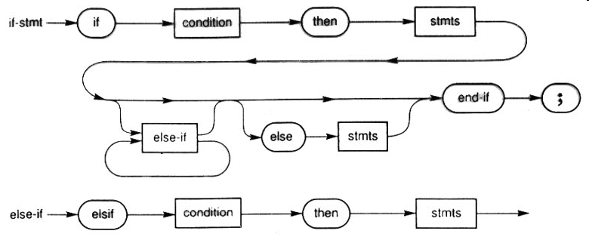
Using Syntax Graphs to Describe Syntax

Slide 10
Reasons to Separate Lexical and Syntax Analysis
Simplicity - less complex approaches can be used for lexical analysis; separating them simplifies the parser
Efficiency - separation allows optimization of the lexical analyzer
Portability - parts of the lexical analyzer may not be portable, but the parser always is portable
Better Modularity !

Slide 11
Lexical Analysis
Lexical analyzer transforms the source program into a sequence of tokens.
Tokens that have names associated with them will have a reference to an entry in the symbol table that shows that identifier.
The output of lexical analysis is a sequence of pairs;
  the class of the token
  pointer to the entry in the symbol table.

Slide 12
The lexical analysis output of a Pascal line
a := substr(isim,1,5) + '.....';
  (identifier, ptr1)
  (assignment_operator, nil)
  (identifier, ptr2)
  (leftparenthesis, nil)
  (identifier, ptr3)
  (param_separator, nil)
  (integer, ptr4)
  (param_separator, nil)
  (integer, ptr5)
  (rightparenthesis, nil)
  (addition_operator, nil)
  (string_constant, ptr6)
  (line_separator, nil)
a
substr
isim
1
5
…..

Slide 13
Syntactic Analysis
The syntax analyzer determines whether the given programs are syntactically correct.
Syntactic analysis applies the grammar of the language to create the derivation tree for a program from the sequence of tokens generated by the lexical analyzer. This process is called parsing.
There are two strategies that can be applied in parsing:
  top-down
  bottom-up

Slide 14
Top-down parsing starts with the goal symbol and replaces that symbol with one of its alternative definitions that matches the string of tokens.
This process continues until no unmatched nonterminals remain.
In this process, backtracking may be used.
  Backtracking means to return to the most recent substitution where there are untested definitions and then to use one of those alternative definitions.

Slide 15
Bottom-up parsing starts with a string of tokens and tries to match its substrings to the right-hand sides of rules and substituting the defined nonterminal.
This process continues until the goal symbol is reached.

Slide 16
Semantic Analysis
Semantic analysis uses the parse tree that is produced by the syntax analyzer to generate an abstract program.
Abstract program is represented in an intermediate language.
Intermediate languages are similar to assembly language.
Ex: Three-address code (TAC or 3AC )

Slide 17
Code Generation
Code generation replaces the abstract language statements by parameterized object code templates.
For example the following instruction;
ADD a,b,c
may be translated into a couple of instructions by the code generator in a target language such as:
  MOVE loc(a), R1
  ADD loc(b), R1
  MOVE R1, loc(c)

Slide 18
Optimization
Optimizer – may be not the best but better!
Compiler optimization is the process of transforming a program into an equivalent program that will result in more efficient execution.

Slide 19
There are two forms of optimization:
  Object independent optimization
  Object dependent optimization
Object-independent optimization can be performed on the source program or on any of the intermediate forms.
  Examples are repetition of identical computations.
  a= f1 (x+y) + f2(x+y);

Slide 20
Object-dependent optimization can be performed only on the object program and uses properties of the target language to reduce execution time.
Ex: The CPU may have a faster way for that specific operation
Optimizers must be used with care.
It is necessary to turn off the optimizer when debugging.

Slide 21
Pure Interpretation (Implementation method)
No translation
Easier implementation of programs (run-time errors can easily and immediately displayed)
Slower execution (10 to 100 times slower than compiled programs)
Often requires more space
Rare on high-level languages
Significant comeback with some Web scripting languages (e.g., JavaScript)

Slide 22

Pure Interpretation Process

Slide 23
Hybrid Implementation Systems
A compromise between compilers and pure interpreters
A high-level language program is translated to an intermediate language that allows easy interpretation
Faster than pure interpretation
Examples
  Perl, Phyton, Java
Closer to compiled
Closer to interpreted

Slide 24

Hybrid Implementation Process
Compiler

Slide 25
Just-in-Time Implementation Systems
Initially translate programs to an intermediate language
Then compile intermediate language into machine code
Machine code version is kept for subsequent calls
JIT systems are widely used for Java programs
.NET languages are implemented with a JIT system

Slide 26
Preprocessors
Preprocessor macros (instructions) are commonly used to specify that code from another file is to be included
A preprocessor processes a program immediately before the program is compiled to expand embedded preprocessor macros
A well-known example: C preprocessor
  expands #include, #define, and similar macros

Slide 27
Pre-processing the source code
Preprocessor
New Source
Source
Compiler
#define PI 3.14159
#define RADTODEG(x) ((x) * 57.29578)

